Slide 1
The chronology of the Revelation of The Holy Quran

Slide 2
Secured in Preserved Tablet
بَلْ هُوَ قُرْاٰنٌ مَّجِیْدٌۙ(۲۱)فِیْ لَوْحٍ مَّحْفُوْظٍ۠(۲۲) سورہ البروج
Rather, it is the glorious Quran in the Preserved Tablets

Slide 3
Descension took place twice
The whole of it had been sent from “Bait Ul Izzah” also known as “Bait-ul-Mamoor” a place of worship for angels that exists in the firmament facing ka’aba.
This descending took place at the night of Qadr.
This descending aimed to demonstrate the exalted majesty of the Holy Quran, and to tell the angels the finality of Prophet Muhammad ﷺand this book.
Second time, it was revealed to the Holy Prophet gradually as needed.
Two-timed descending also aimed at stressing that this book is beyond all doubts.

Slide 4
Continued
6. It is preserved in two more places than the blessed heart of the Prohphet Muhammad ﷺ.
7. It completed in 23 years.
Second descending began at the age of 40 year.
the descending of the Holy quran in the month of Ramadhan. However, the exact date is not definite. 17th of Ramadhan, the day of the Battle of Badr. 27th of Ramadhan etc.

Slide 5
The verses that come first.
Dreams
Seclusion
Angel came in Cave of Hira.

Slide 6
Continued
The very first verses to come were the first five verses of Surah Al-Alaq.
’’اِقْرَاْ بِاسْمِ رَبِّكَ الَّذِیْ خَلَقَۚ(۱) خَلَقَ الْاِنْسَانَ مِنْ عَلَقٍۚ(۲)اِقْرَاْ وَ رَبُّكَ الْاَكْرَمُۙ(۳) الَّذِیْ عَلَّمَ بِالْقَلَمِۙ(۴) عَلَّمَ الْاِنْسَانَ مَا لَمْ یَعْلَمْ‘‘
Recite: In the Name of your Lord, who created.
Created man from a clinging clot.
Read: And your Lord is the Most Generous.
He Who taught by the pen. Taught man what he never knew.

Slide 7
Wahy discontinued for three years
The wahy discontinued for three years.
This era of discontinuation is also know as “Time of Fatrah”
Then the same angel the Prophet Muhammad ﷺ had seen in the cave of
came again and recited before him the verses of Surah Muddathir.

Slide 8
The Makki and Madani Verses
Verses revealed before migration to Medina are called “Makki Suras” even in Arafat, Mina or during the journey of Mairaj.
Verses revealed after the migration to Medina is called “Madani Suras”.
Some verses revealed during the journey to M.edina are also “Makki”
اِنَّ اللّٰهَ یَاْمُرُكُمْ اَنْ تُؤَدُّوا الْاَمٰنٰتِ اِلٰۤى اَهْلِهَاۙ
Surely, Allah commands you to fulfil trust obligation towards those entitled to them.
This verse is Madani although it was revealed in Makkah.

Slide 9
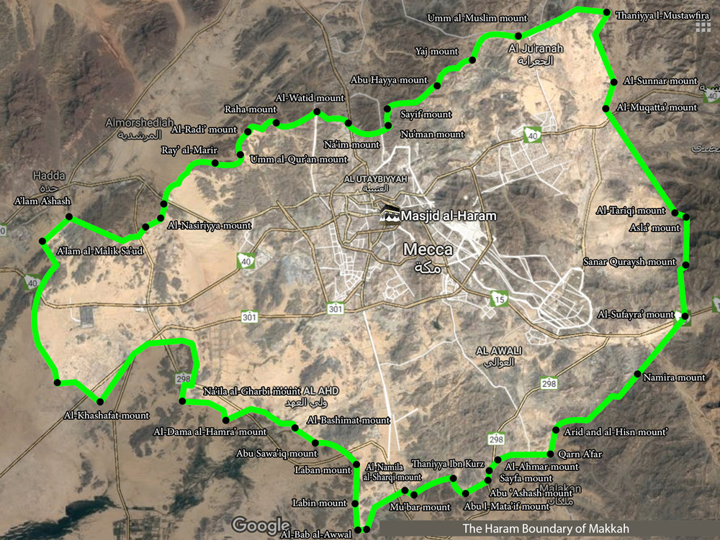
The difference betwee
n Makki and Madani verses.

Slide 10
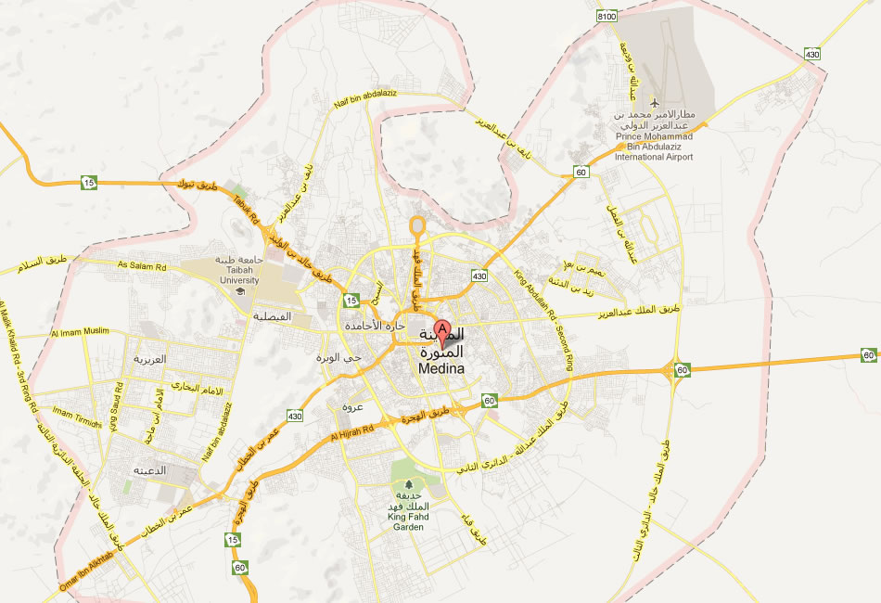

Slide 11
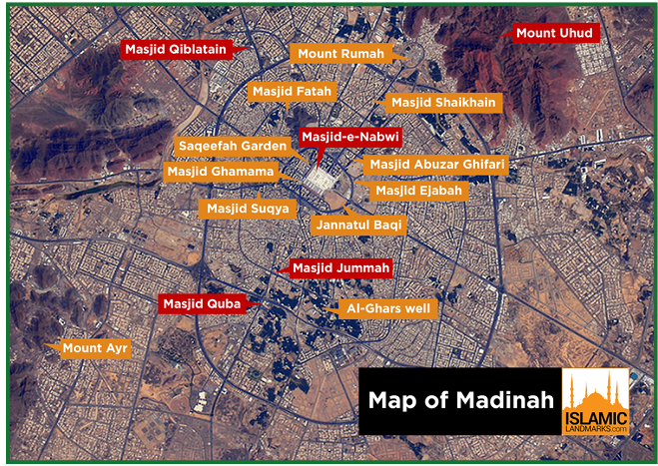

Slide 12
Characteristics of Makki and Madani Verses.
Some of the universal rules are as follow:
Every surah in which the word “کلا” appears is Makki. This word used 33 times in 15 verses. ( All these are in the last half of the Quran.)
Verse of sajda are Makki Surahs, According to Hanafi school of thought.
Surah having the story of Adam (A.S) and Iblees, except Surah Baqara, is Makki.
Having permission of Jihad is Madani.
Mentioning the hypocrites of Madina is Madani.

Slide 13
Characteristics of Makki and Madani Verses. (continued)
General and mostly frequent characteristics.
یٰۤاَیُّهَا النَّاسُ Makki surah
یٰۤاَیُّهَا الَّذِیْنَ اٰمَنُوْۤا Madani surah..
Makki surahs are short and brief while Madani surahs and chapter are long.
The subject of Makki suras are Oneness of Allah, Prophethood, Qayamah…affirmation of life hereafter, panorama of resurrection, while in Madani surahs family, social laws, jihad etc.
In makki suras, the confrontation is with idiolaters, while in madani suras is with the people of books, hypocrites.

Slide 14
The gradual revelation of the Holy Quran
Many purpose…

Slide 15
جزاکم اللہ خیرا
Thank you very much
The End.

